Slide 1
RUNTASTIC
OUR APPROACH TO MONETIZATION
Vahid Gharaei
Business Development
vg@runtastic.com

Slide 2
WHAT IS RUNTASTIC?

Slide 3
FACTS & FIGURES

Slide 4
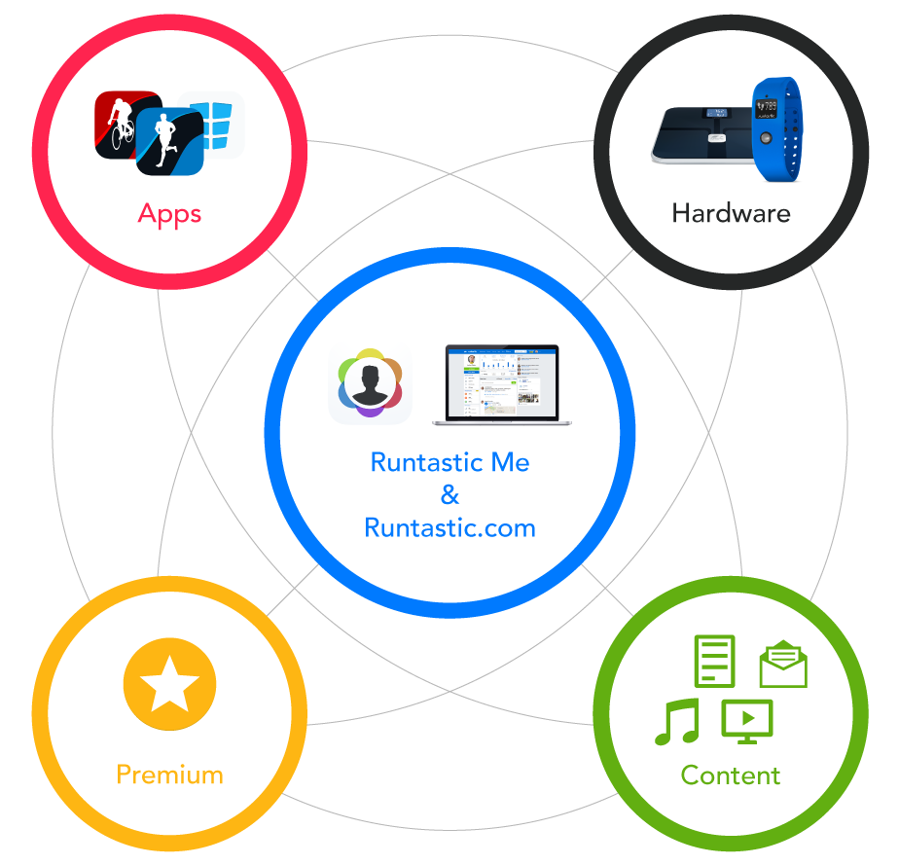
RUNTASTIC ECOSYSTEM
The Runtastic Ecosystem offers users a comprehensive and easy-to-use portfolio of health and fitness products, services & content. Why? Because we want our users to track their daily lives and develop better awareness of how they’re living. We want to help them reach their goals, live better & live longer. #Runtastic #LiveLong

Slide 5
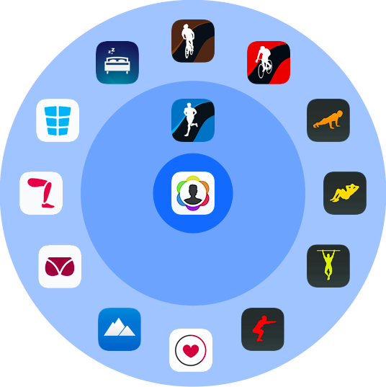
?
RUNTASTIC APP ECOSYSTEM
Runtastic offers users a full suite of health & fitness apps to help them live consciously, meet personal goals and have fun along the way. Apps are released, updated and optimized in an ongoing manner to best serve users.

Slide 6
MONETIZATION
How will you monetize your app(s)?
Build this into your product strategy and development
Freemium model - find the right mix
Can you survive on ads?
#1 reason people pay for an upgrade
Mobile Ad Spend grew by 65% in 2014*
Follow the latest monetization trends
Go free and focus on recurring subscription revenue
*Interactive Advertising Bureau

Slide 7
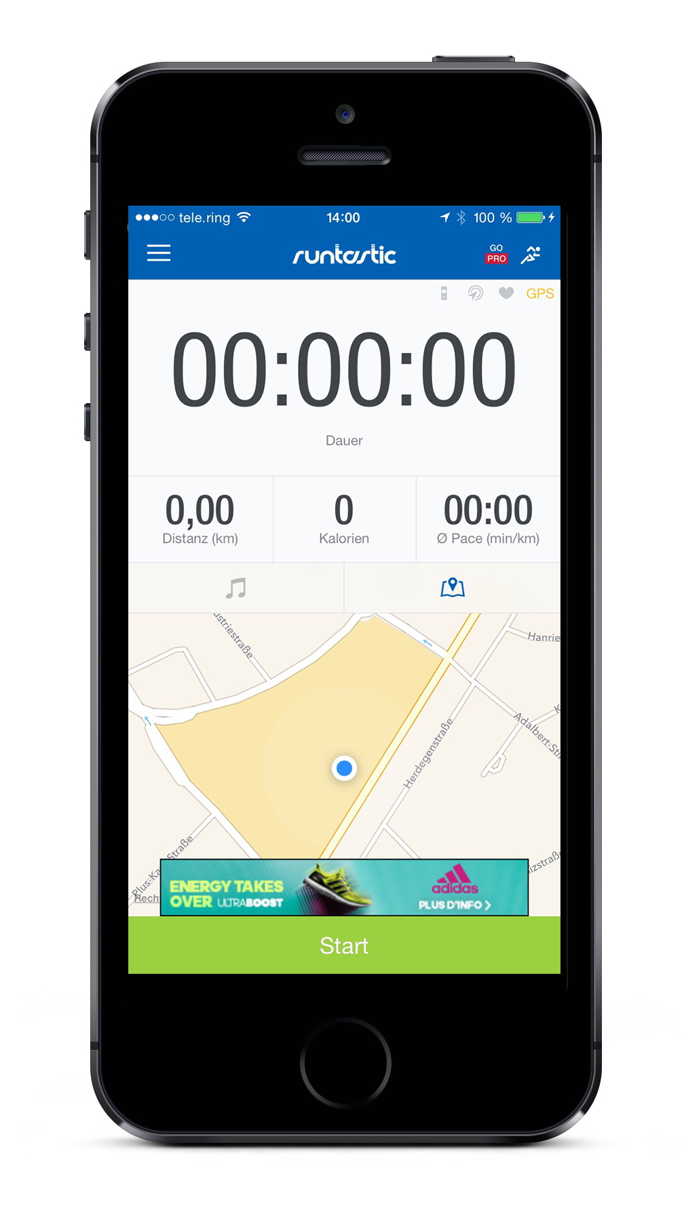
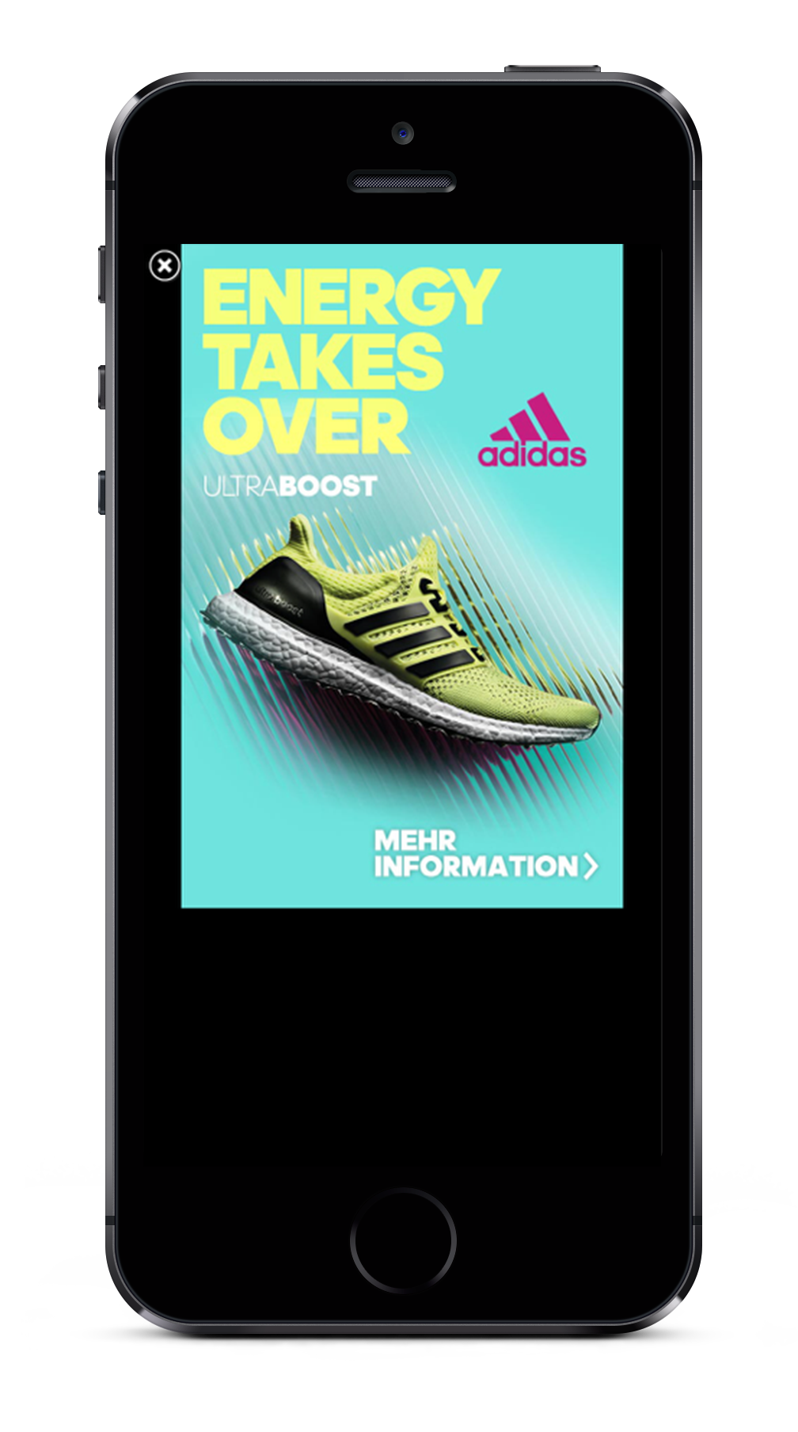
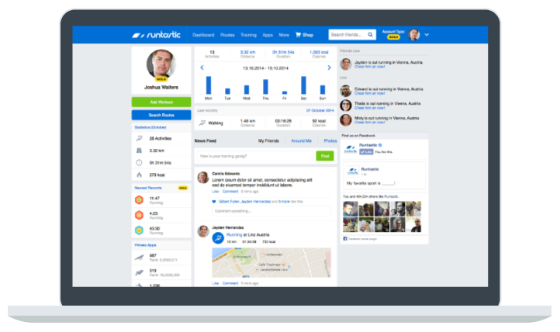
ADVERTISING
+
RUNTASTIC.COM
IN-APP

Slide 8
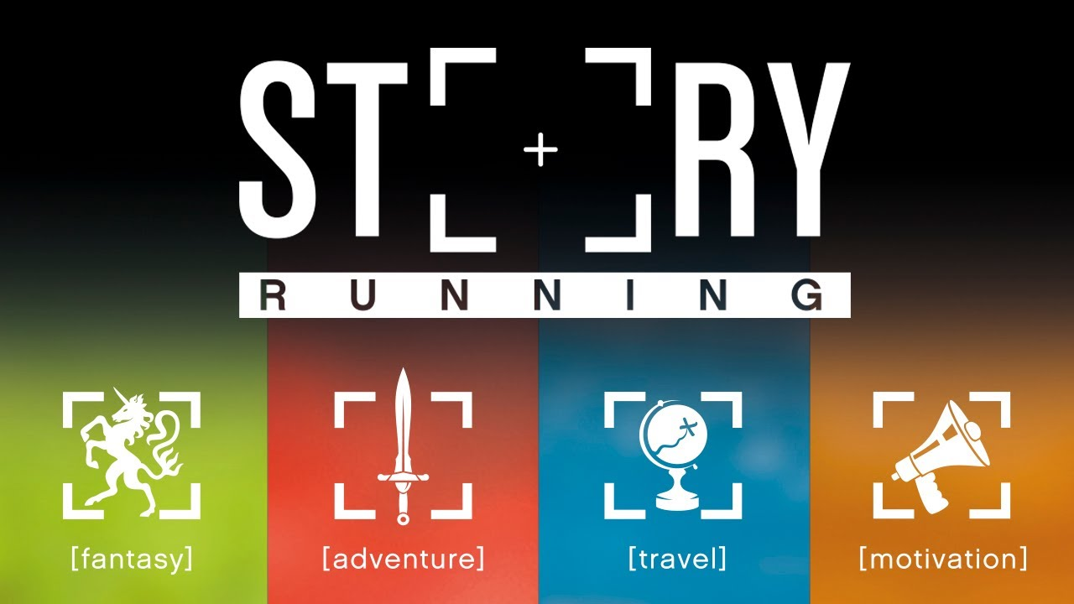
IN APP PURCHASE (IAP)
+
CONSUMABLES
ONE-TIME

Slide 9
RUNTASTIC MEMBERSHIP
FREEMIUM MODEL
PREMIUM
Free membership has to be functional
Free membership creates a value proposition for Premium
Premium benefits includes functions, features and value:
No ads across web and core apps
IAP benefits for free
Additional features (Training Plans, Records, Statistics, etc.)
FREE

Slide 10
OPTIMIZE MONETIZATION
Create Value
Have a Purpose
Optimize the User Journey
A/B Testing
Engage The User

Slide 11
CREATE VALUE

Slide 12
Inspiration.
Instruction.
Transformation.
#Runtastic #Results #RR

Slide 13
OPTIMIZE MONETIZATION
Create Value
Have a Purpose
Optimize the User Journey
A/B Testing
Engage The User

Slide 14
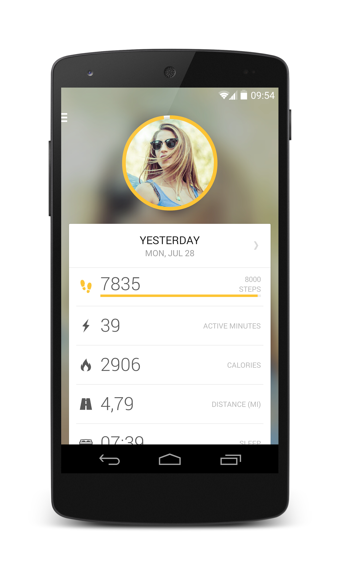
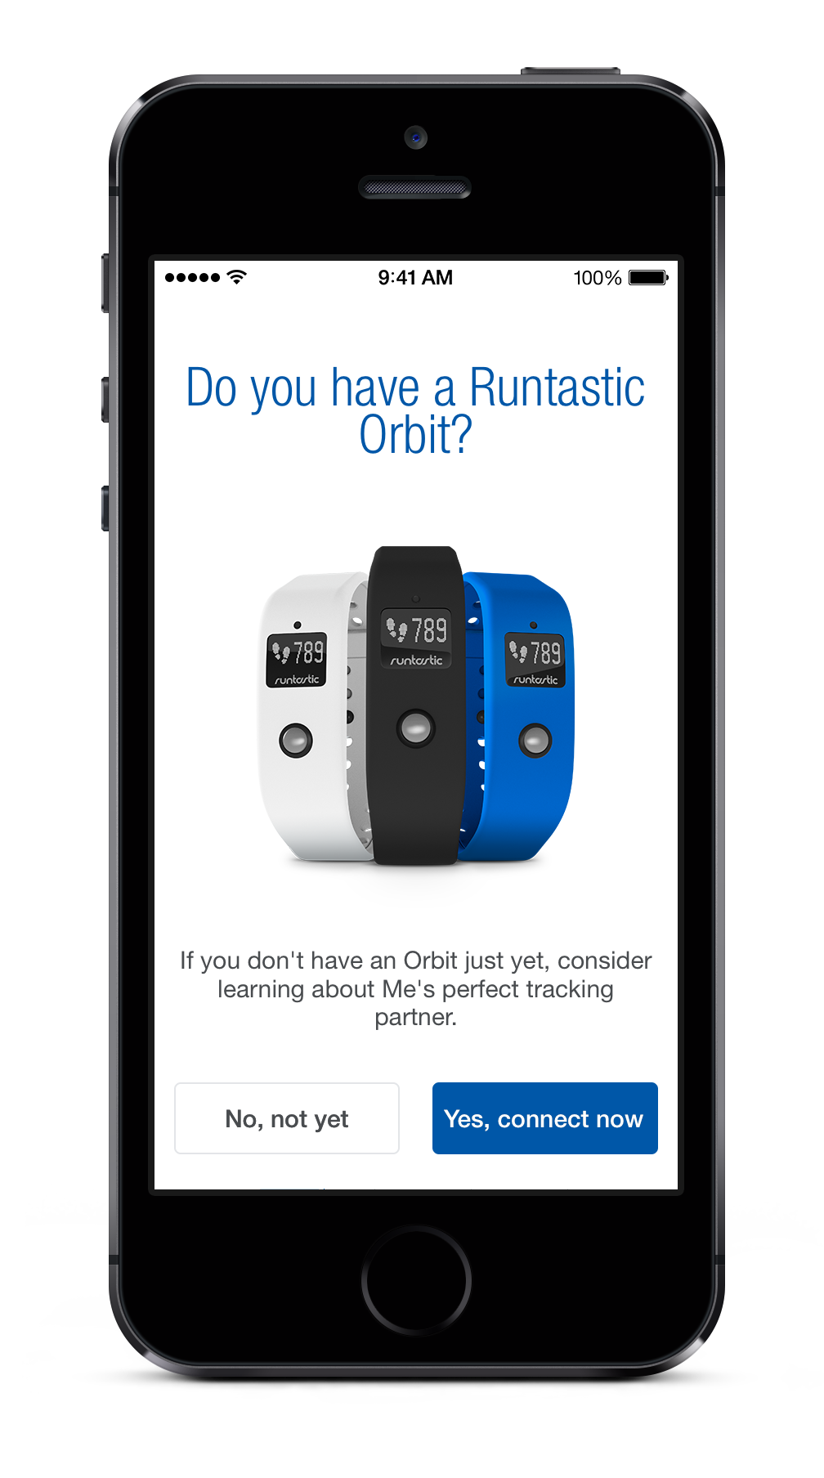
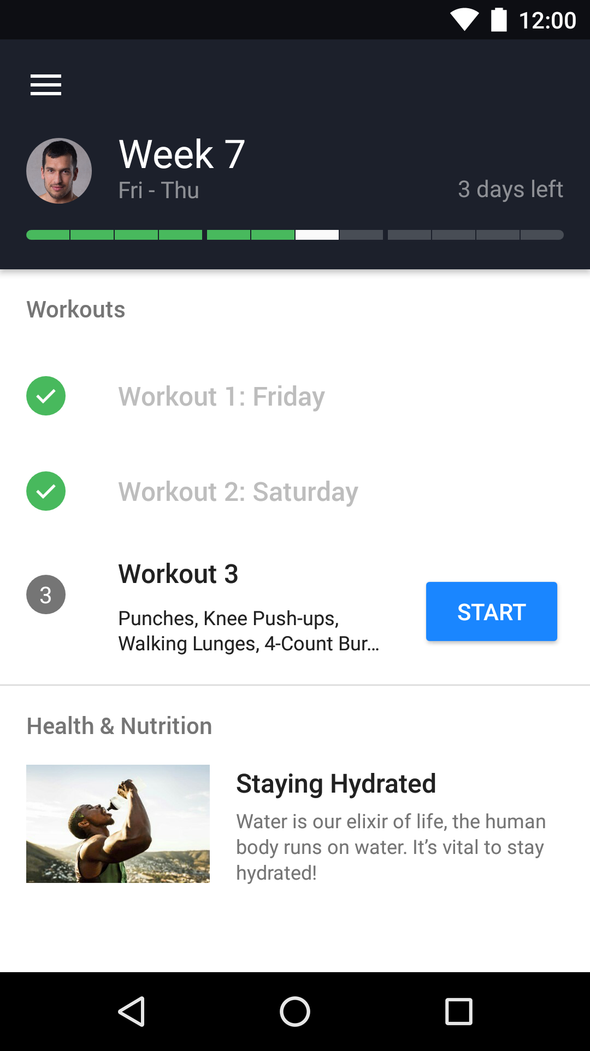
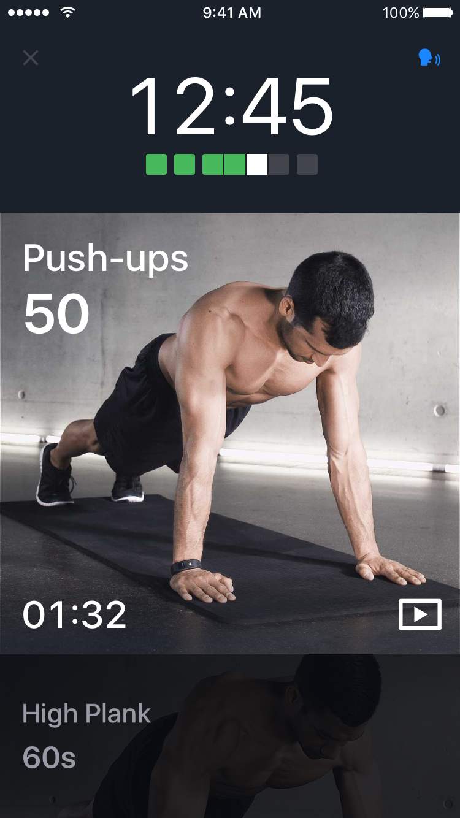
RUNTASTIC RESULTS
HAVE A PURPOSE:
· Bodyweight training is a huge trend
· Users now have complete indoor/outdoor training
· Provides full-body training
· Customized training plans
· Actionable plans for improvement
· Runtastic Premium based

Slide 15
OPTIMIZE MONETIZATION
Create Value
Have a Purpose
Optimize the User Journey
A/B Testing
Engage The User

Slide 16
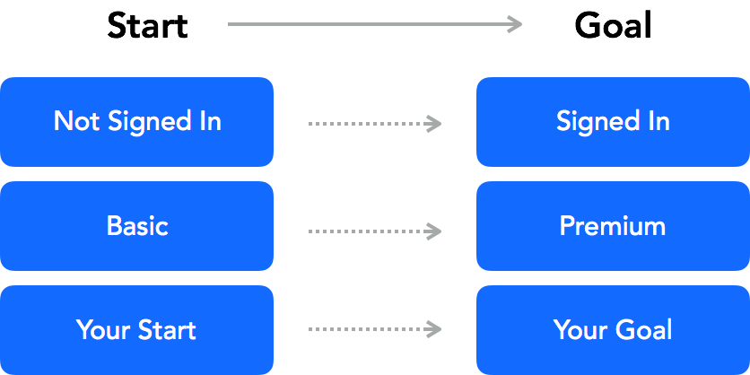
USER JOURNEY
Define what you want your users to do:
Start: What/Where do they begin?
Goal: What are you trying to get them to achieve?

Slide 17
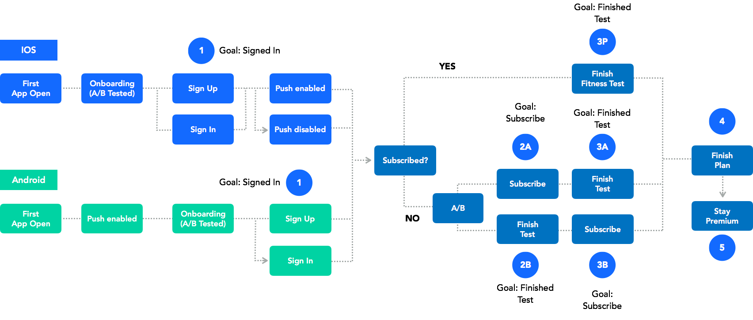
USER JOURNEY MAP

Slide 18
IF YOU DON’T KNOW THE DIRECTION USERS SHOULD GO, NEITHER WILL THEY.

Slide 19
OPTIMIZE MONETIZATION
Create Value
Have a Purpose
Optimize the User Journey
A/B Testing
Engage The User

Slide 20
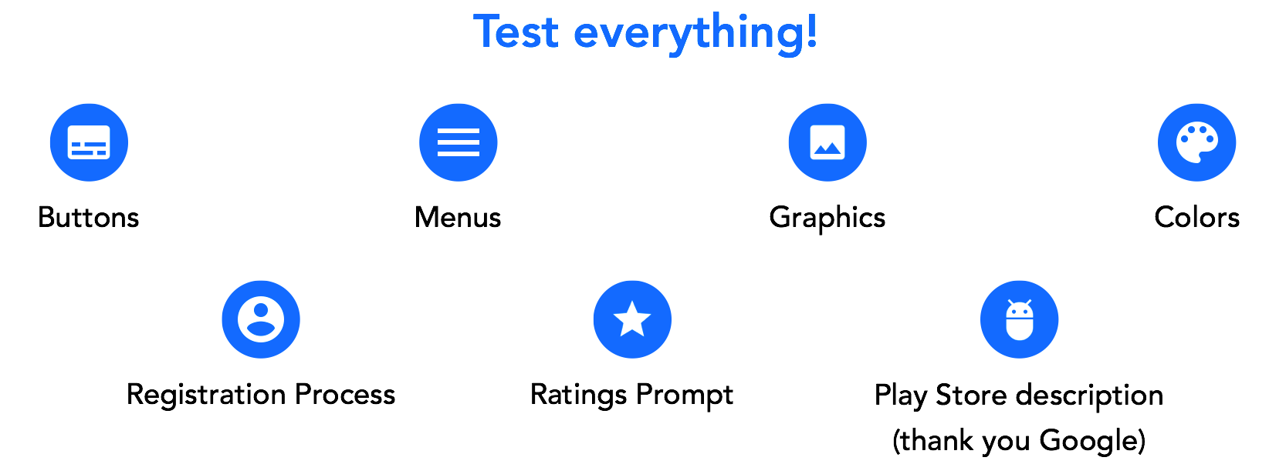
A/B TESTING

Slide 21
OPTIMIZE MONETIZATION
Create Value
Have a Purpose
Optimize the User Journey
A/B Testing
Engage The User

Slide 22
USER ENGAGEMENT

Slide 24
THANKS!
WE ARE HIRING! COME TALK TO ME!
Vahid Gharaei
Business Development
vg@runtastic.com

